Slide 1




SRM
Institute of Science and Technology
Compiler Design mini projet
Title : ‘Build a Python IDE’
Team members
APEKSHA SEHRAWAT(RA1911028010073)
SHIVANSH(RA1911028010076)
ARPAN MISHRA(RA1911028010082)
Section : I2
Code : 18CSC304j
Supervised By
DR.VIJAY VASANTH

Slide 2

INTRODUCTION
Python is one of the most famous programming languages. Python is an interpreted programming language and has different execution environments. It has a wide range of compilers to execute the python programs eg. PyCharm, PyDev, Jupyter Notebook, Visual Studio Code, and many more.
The compiler is a special program that is written in a specific programming language to convert the human-readable language i.e. high-level language to machine-readable language i.e. low-level language

Slide 3
Aim & Objectives
To create a real own python Compiler by using python and Compiler design concept
Compile refers to the act of converting programs written in high level programming language, which is understandable and written by humans, into a low level binary language understood only by the computer

Slide 4
Module 01
Pycharm (Python IDE)
Tkinter (Library)
Subprocess (python dictionary)
Pandas (Library)

Slide 5
PYCHARM IS A DEDICATED PYTHON INTEGRATED DEVELOPMENT ENVIRONMENT (IDE) PROVIDING A WIDE RANGE OF ESSENTIAL TOOLS FOR PYTHON DEVELOPERS, TIGHTLY INTEGRATED TO CREATE A CONVENIENT ENVIRONMENT FOR PRODUCTIVE PYTHON, WEB, AND DATA SCIENCE DEVELOPMENT.
ADVANTAGES AND DISADVANTAGES OF USING PYCHARM
A PLETHORA OF PRODUCTIVE SHORTCUTS.
ABILITY TO VIEW THE ENTIRE PYTHON SOURCE CODE WITH A SINGLE CLICK.
AVAILABILITY OF AN ARRAY OF PLUGINS.
EASY-TO-USE.
EXCELLENT COMMUNITY SUPPORT.
FACILITATES FASTER CODE DEVELOPMENT.
MORE POWERFUL, COMMERCIAL VERSION AVAILABLE.
Pycharm (Python IDE)

Slide 6
TKINTER IS A PYTHON BINDING TO THE TK GUI TOOLKIT. IT IS THE STANDARD PYTHON INTERFACE TO THE TK GUI TOOLKIT, AND IS PYTHON'S DE FACTO STANDARD GUI. TKINTER IS INCLUDED WITH STANDARD GNU/LINUX, MICROSOFT WINDOWS AND MACOS INSTALLS OF PYTHON. THE NAME TKINTER COMES FROM TK INTERFACE.
IN PYTHON, TKINTER IS A STANDARD GUI (GRAPHICAL USER INTERFACE) PACKAGE. TKINTER IS PYTHON'S DEFAULT GUI MODULE AND ALSO THE MOST COMMON WAY THAT IS USED FOR GUI PROGRAMMING IN PYTHON. NOTE THAT TKINTER IS A SET OF WRAPPERS THAT IMPLEMENT THE TK WIDGETS AS PYTHON CLASSES.
Tkinter

Slide 7
THE SUBPROCESS MODULE ALLOWS YOU TO SPAWN NEW PROCESSES, CONNECT TO THEIR INPUT/OUTPUT/ERROR PIPES, AND OBTAIN THEIR RETURN CODES. THIS MODULE INTENDS TO REPLACE SEVERAL OLDER MODULES AND FUNCTIONS: OS. SYSTEM OS.
A PROCESS THAT IS PART OF A LARGER PROCESS THE WIRE TRANSFER PROCESS IS DIVIDED INTO TWO SUBPROCESSES
Subprocess (python dictionary)

Slide 8
PANDAS IS A PYTHON LIBRARY FOR DATA ANALYSIS. STARTED BY WES MCKINNEY IN 2008 OUT OF A NEED FOR A POWERFUL AND FLEXIBLE QUANTITATIVE ANALYSIS TOOL, PANDAS HAS GROWN INTO ONE OF THE MOST POPULAR PYTHON LIBRARIES. IT HAS AN EXTREMELY ACTIVE COMMUNITY OF CONTRIBUT
A PANDAS SERIES IS A ONE-DIMENSIONAL LABELLED DATA STRUCTURE WHICH CAN HOLD DATA SUCH AS STRINGS, INTEGERS AND EVEN OTHER PYTHON OBJECTS. IT IS BUILT ON TOP OF NUMPY ARRAY AND IS THE PRIMARY DATA STRUCTURE TO HOLD ONE-DIMENSIONAL DATA IN PANDAS. IN PYTHON, A PANDAS SERIES CAN BE CREATED USING THE CONSTRUCTOR PANDAS
Pandas (Library)

Slide 9
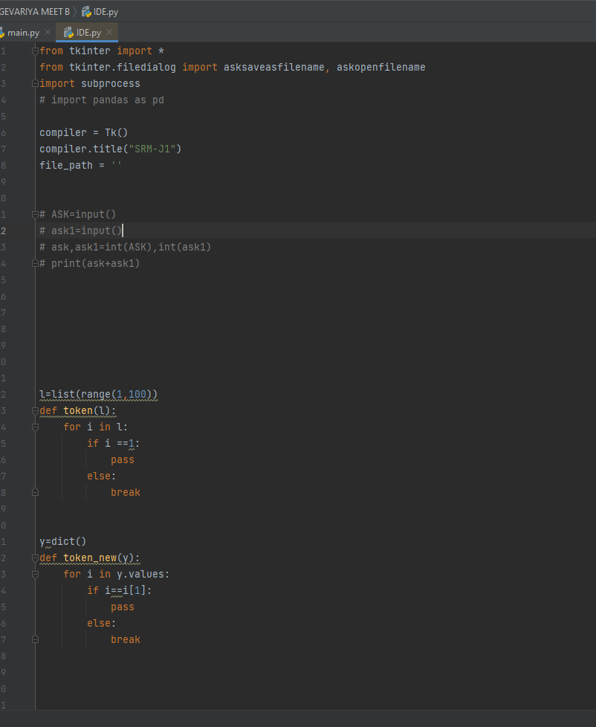
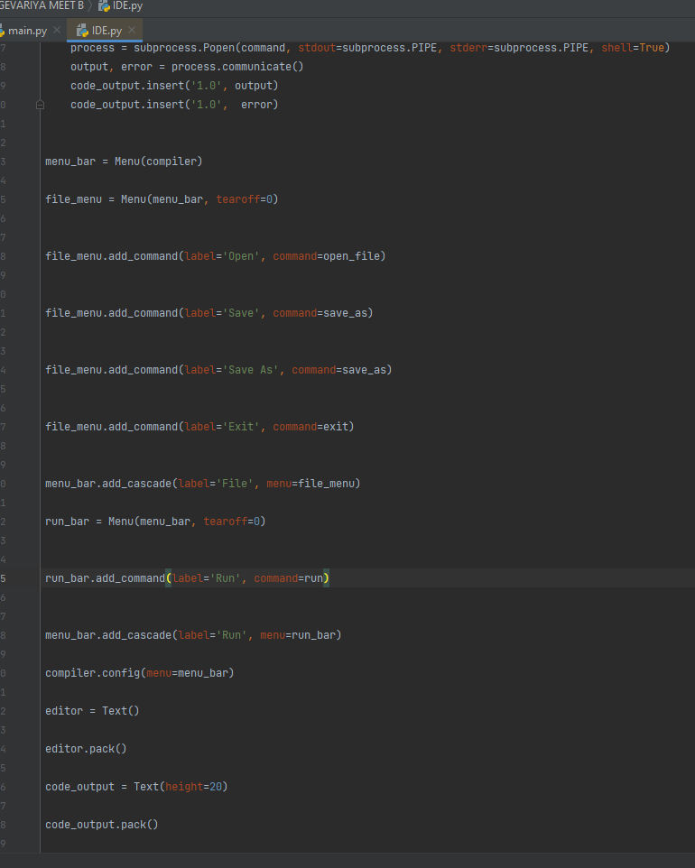
Coding area

Slide 10
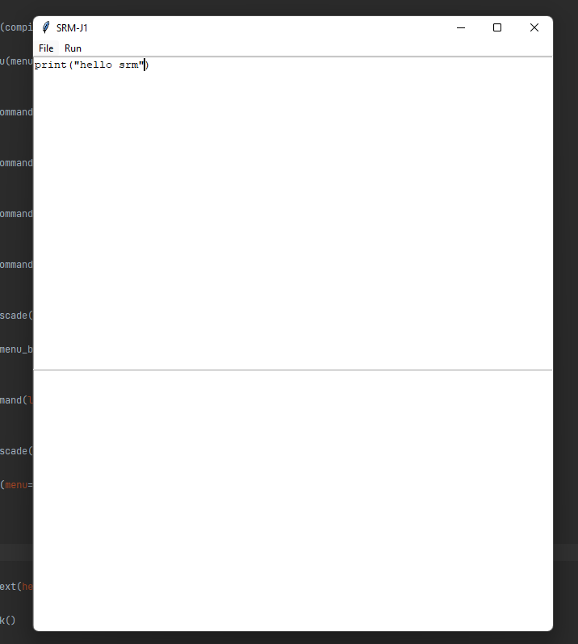
Output as a python IDE

Slide 11
Conclusion and Future work
Over the course of this semester our group was able to create a compiler for the PYTHON language from beginning to end. Testing was performed at four critical junctions, after implementing the scanner, after creating the parser, after creating a parse tree generator, and finally after the code generation step.
In the future, we plan to expand on the foundation created in this course. Expansion will focus on the ability to add more functionality to the compiler as well as memory management. Currently the compiler is capable of running the 15 3AC codes. Future utilization of this project should allow for the functionality of shifting statements as well as logical operations.

Slide 12



THANK YOU

